Slide 1
Flickr.com vs. Phanfare.com
Web-based Photo Management Services
Sarah Bradley, Deirdre Douglas-Hubbard, & Lizz Quirk

Slide 2

Web-based Photo Management Services
Organize
Share
Exchange
Comment
Search
Create

Slide 3
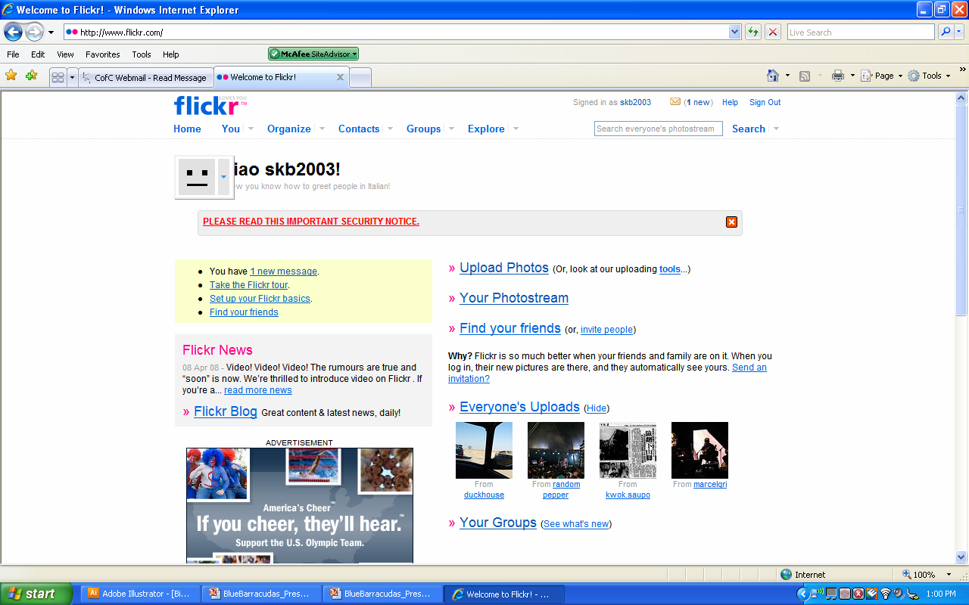
Ease of Use: Flickr
Dropdown Menu w/ Upload Button
Fewer Routes
User-Friendly Taskbar

Slide 4
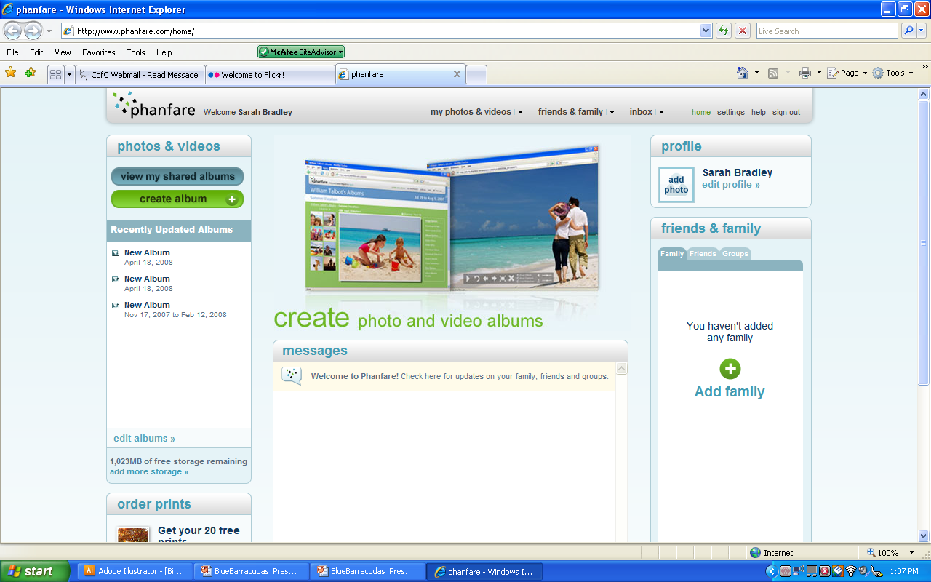
Ease of Use: Phanfare
Drag and Drop photos
More Routes, Less Organized
Elaborate Website Layout

Slide 5
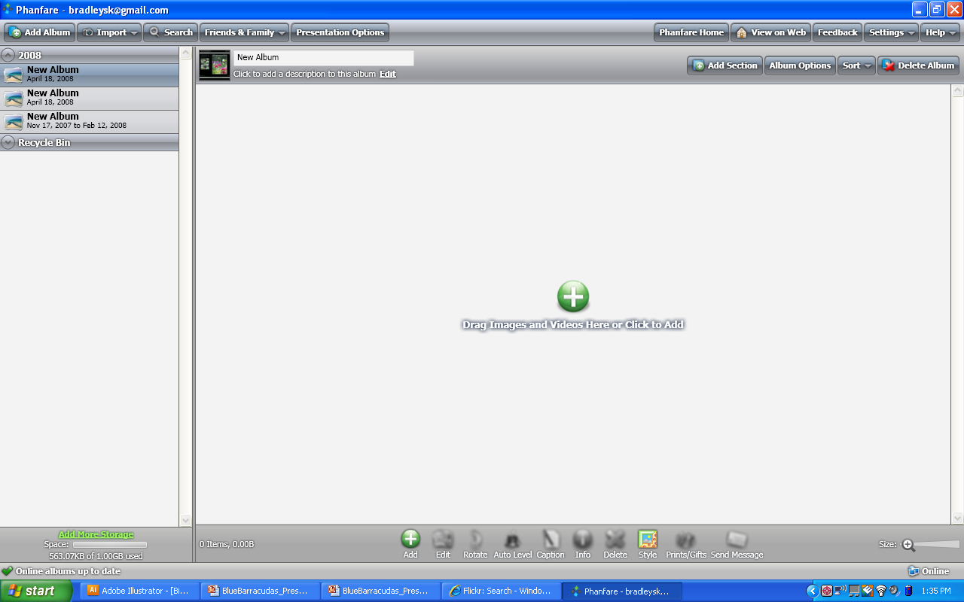
Ease of Use Contd.: Phanfare

Slide 6
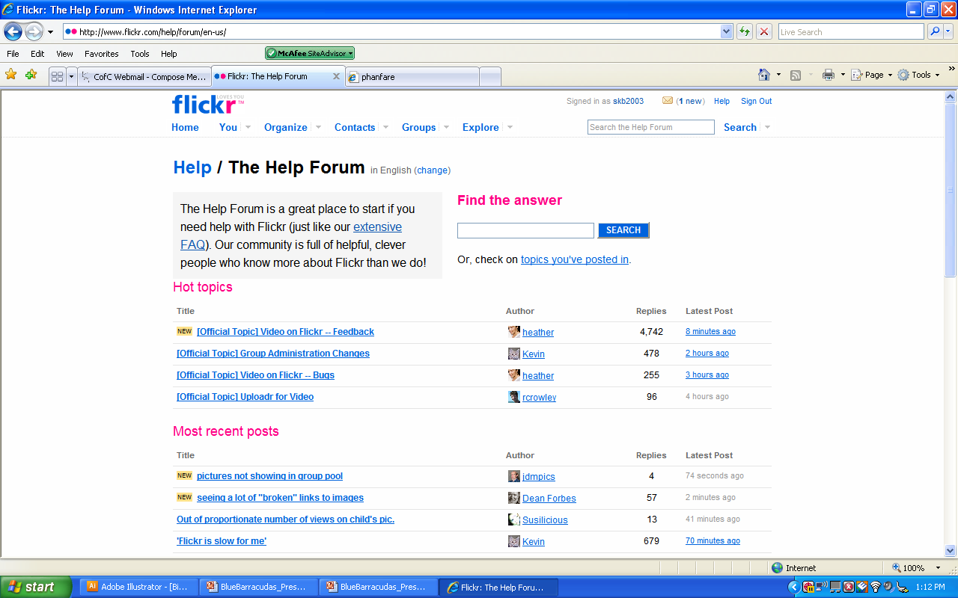
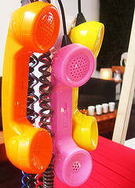
Help Services
Flickr
E-mail
Website Guide
Help Blog
Phanfare
E-mail
Website Guide
Toll-free Number

Slide 7
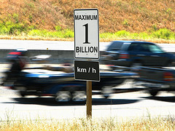
Speed and Availability
Flickr
Upload Quick and Easy
Initialization Time Faster
Easy Login and Access
Phanfare
Desktop Application Slow
Download Time Slow
Continual Session Time-Out

Slide 8
Initialization
Flickr
Free Membership- Yahoo
$24.95 Pro-membership
Quick Login
Phanfare
$54.95 a year, $6.95 a month
Time consuming an confusing
Download slow

Slide 9
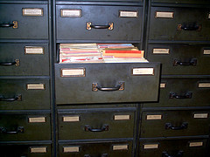
File Management
Flickr
100 MB a month
Pro membership- Unlimited File Space
Albums
Advanced Sharing Features
Phanfare
1 GB a month
Albums
Desktop Application

Slide 10
Features
Flickr
Language Options
“Spell It Out”
“Tagnautica”
“Flickr-Vision”
Phanfare
Photos from Phone to PC
Video
“Protect”

Slide 11

Usability
Flickr
Take the Tour button
Integrated Search Engine
Phanfare
Take the Tour button
Learn More

Slide 12
Conclusion
Flickr is better!
Even the Library of Congress thinks so.

Slide 13
Suggestions for Improvement
Flickr
Video
Phanfare
More Sharing Tools
Better Organization
Integration of Desktop Application

Slide 14
References
Bradley, Sarah Katherine. Interview with Rachel Bradley (avid Flickr user). 6 April 2008.
Helm, Burt. "WHICH PHOTO SITES ARE BEST?." Business Week (07 Nov. 2005): 88-
90. Academic Search Premier. EBSCO. [Library name], [City], [State
abbreviation]. 6 Apr. 2008
<http://search.ebscohost.com.nuncio.cofc.edu/login.aspx?direct=true&db=aph&A
N=18699218&site=ehost-live>.
Jefferson, Graham. "Pictures worth more than a thousand words on upgraded photo ..."
USA Today (n.d.). Academic Search Premier. EBSCO. [Library name], [City],
[State abbreviation]. 6 Apr. 2008
<http://search.ebscohost.com.nuncio.cofc.edu/login.aspx?direct=true&db=aph&A
  N=J0E319327682107&site=ehost-live>.
Johnson, Dave. "Upgrade Your Flickr Experience With Free Tools." PC World 26.3
(Mar. 2008): 126-126. Academic Search Premier. EBSCO. [Library name],
[City], [State abbreviation]. 6 Apr. 2008
<http://search.ebscohost.com.nuncio.cofc.edu/login.aspx?direct=true&db=aph&A
N=29380693&site=ehost-live>.
"LC Teams with Flickr." American Libraries 39.3 (Mar. 2008): 30-30. Academic Search
Premier. EBSCO. [Library name], [City], [State abbreviation]. 6 Apr. 2008 <http://search.ebscohost.com.nuncio.cofc.edu/login.aspx?direct=true&db=aph&AN=31186720&site=ehost-live>.

Slide 15
References
Metz, Cade. "A PHOTO MANAGEMENT APP WORTH SHARING." PC Magazine
26.4 (20 Feb. 2007): 44-44. Academic Search Premier. EBSCO. [Library name],
[City], [State abbreviation]. 6 Apr. 2008
<http://search.ebscohost.com.nuncio.cofc.edu/login.aspx?direct=true&db=aph&A
  N=23846418&site=ehost-live>.
Metz, Cade. "Five New Approaches to Photo Sharing." PC Magazine 25.6 (11 Apr.
2006): 58-59. Academic Search Premier. EBSCO. [Library name], [City], [State
abbreviation]. 6 Apr. 2008 <http://search.ebscohost.com.nuncio.cofc.edu/login.aspx?direct=true&db=aph&A
N=20240891&site=ehost-live>.

